Slide 1
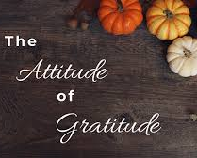
CDR Valarie Gardner, LCSW, BCD
Work-Life, Deputy Chief

Slide 2
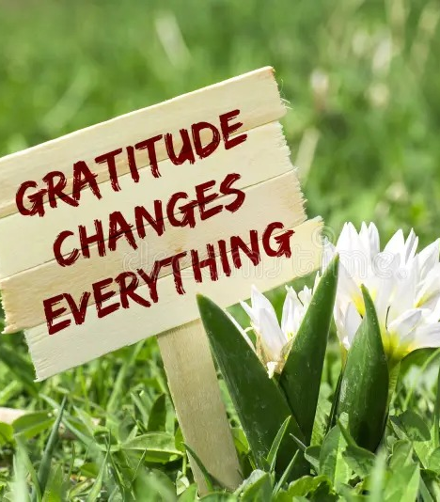
Disclaimer
This presentation is for educational purposes only. The Ideas and views expressed are based on my professional judgement, experience, and research and are not that of the USCG.
This Presentation is being recorder, please do not share anything that would embarrass your mother, child or significant other.
Your participation is welcome!

Slide 3
Gratitude: What Comes to Your Mind When You Think of Gratitude?

Slide 4
Key Take Aways
What is Gratitude
Benefits of Gratitude
Daily Cultivating of Gratitude
What Will You Do Differently

Slide 5
What Is Gratitude?
Is it a “state” or a “trait” or BOTH?

Slide 6
Gratitude Is:
An emotion usually triggered by perceived positive events.
Encompasses qualities such as grace, graciousness, and gratefulness. It entails recognizing and valuing both tangible and intangible positive aspects, acknowledging their origins beyond oneself, and establishing a connection to something greater, such as others, nature, or a higher power.
Gratefulness is unconditional gratitude, not dependent on external circumstances. A daily practice, perspective regardless of events.

Slide 7
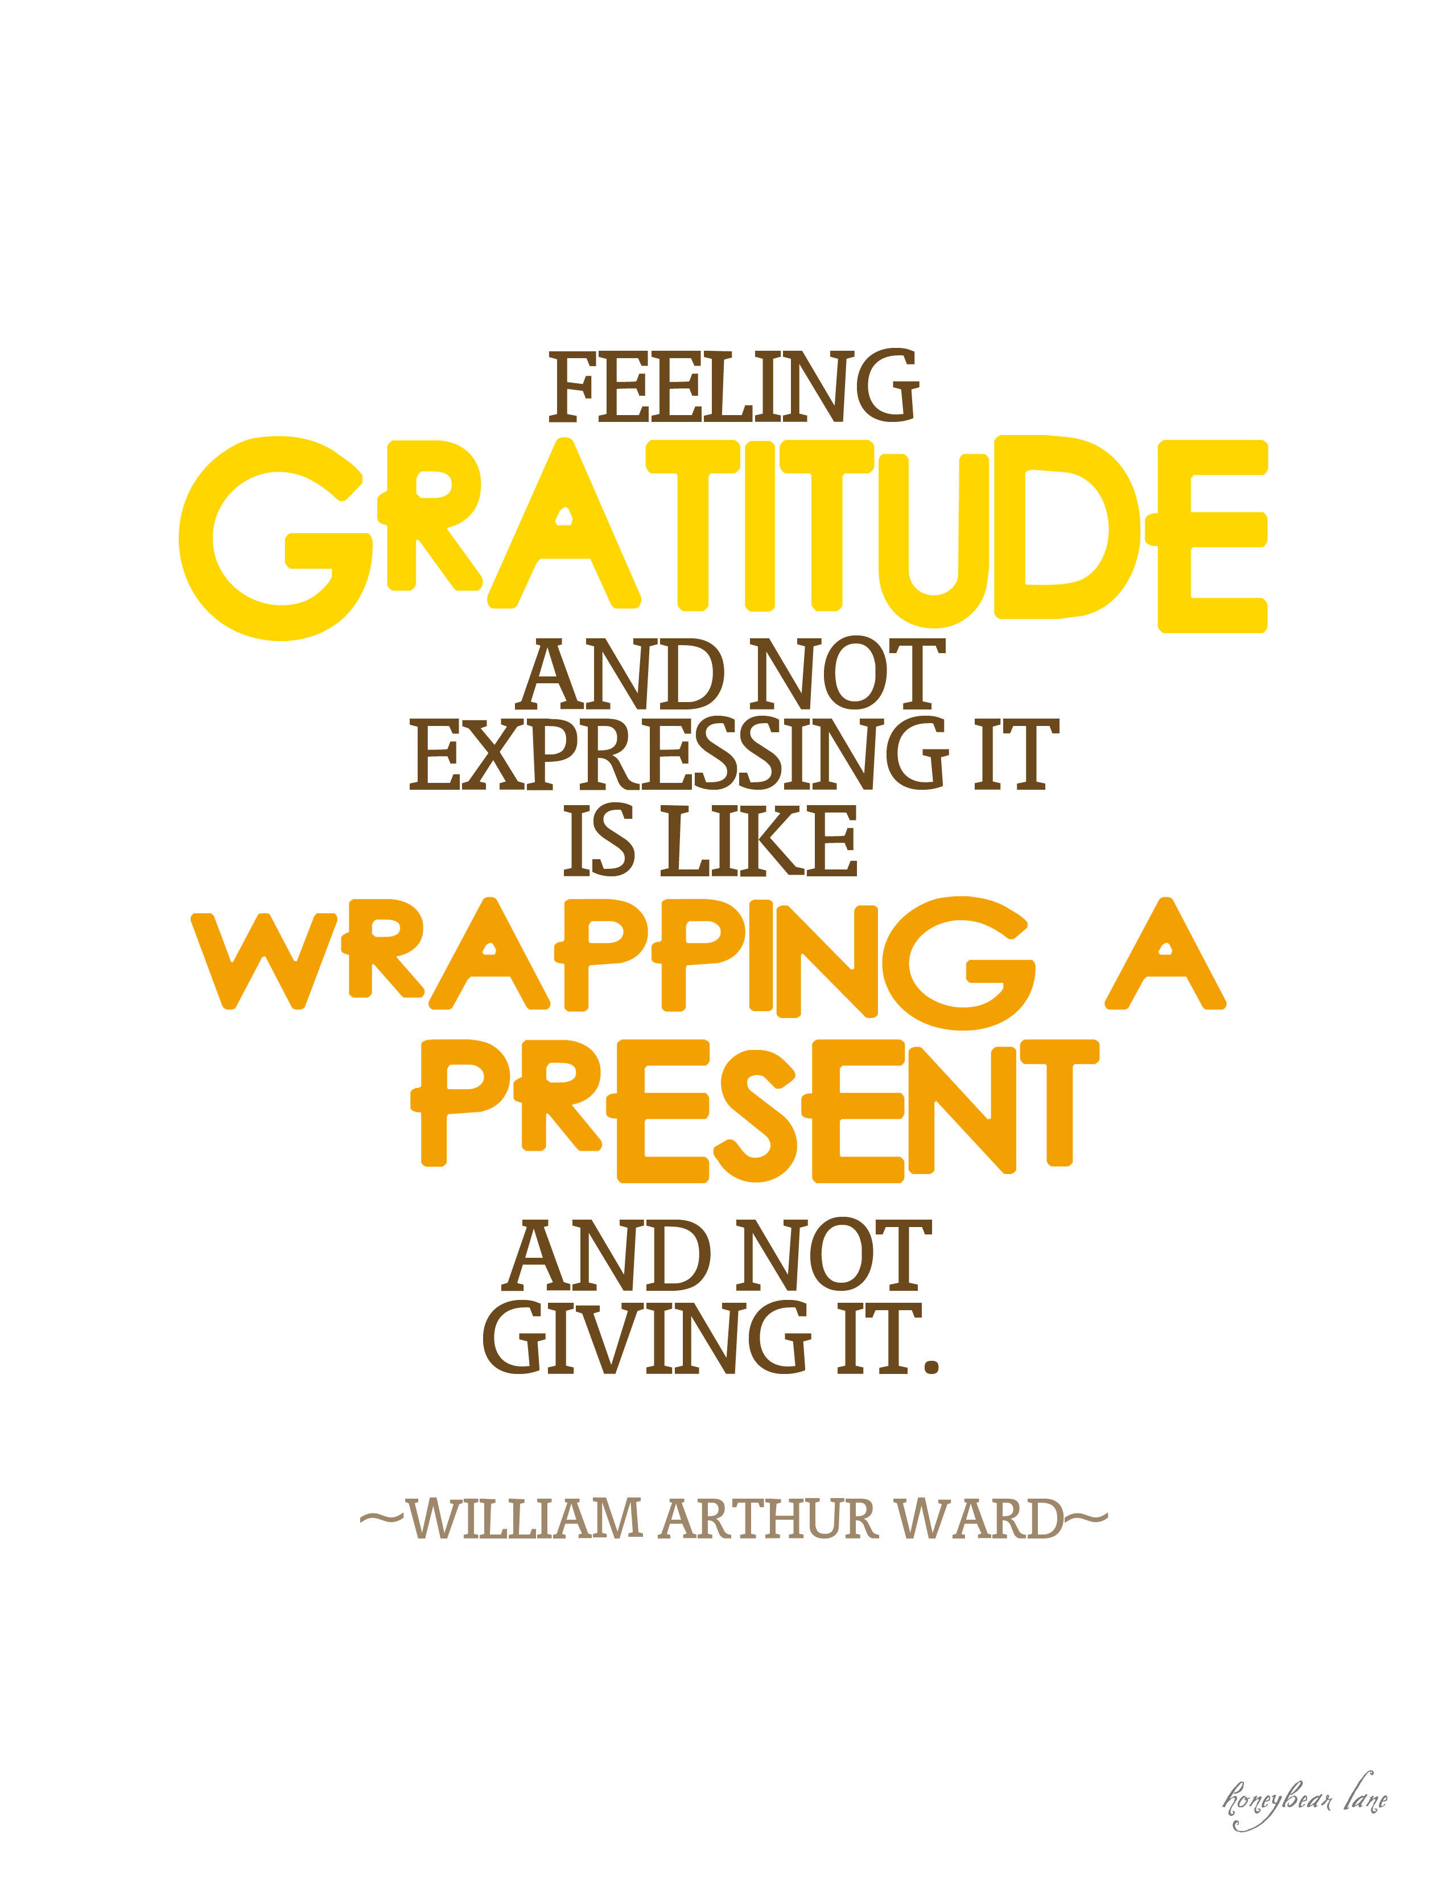
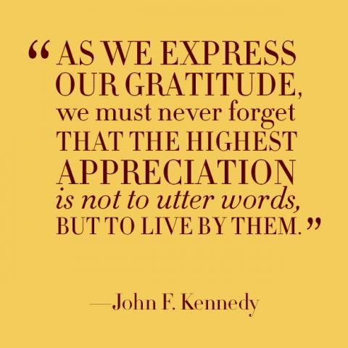
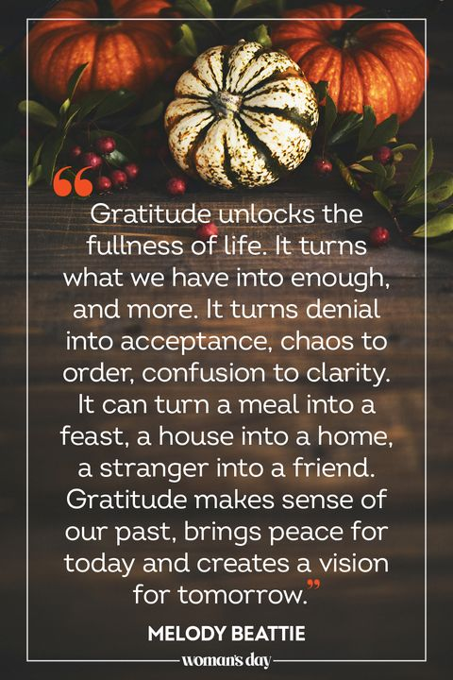
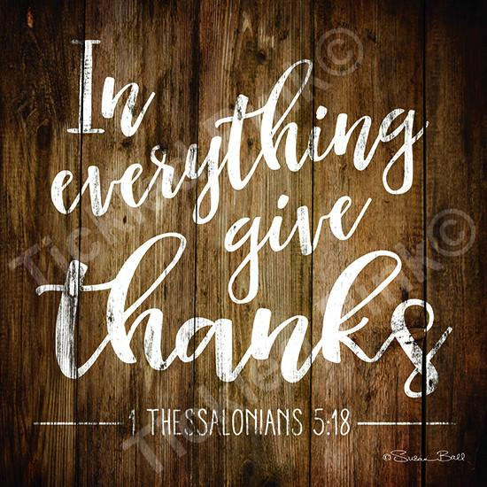
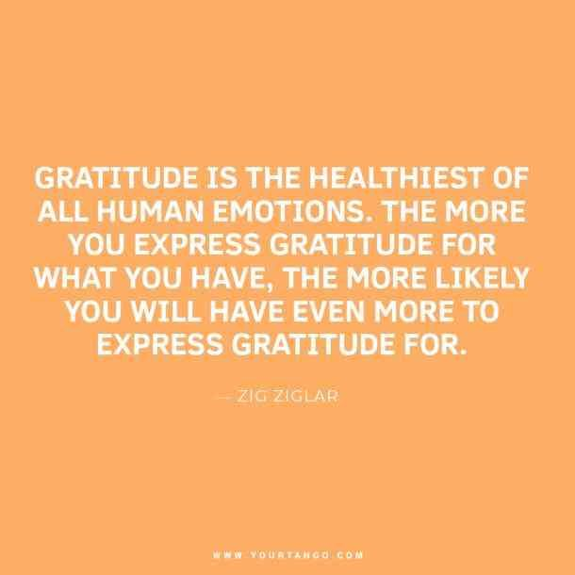
Gratitude Is
BOTH!!!!

Slide 8
Benefits of Gratitude?
A. Psychological
B. Social
C. Physiological
d. All of The above

Slide 9
Benefits of Gratitude

Slide 10
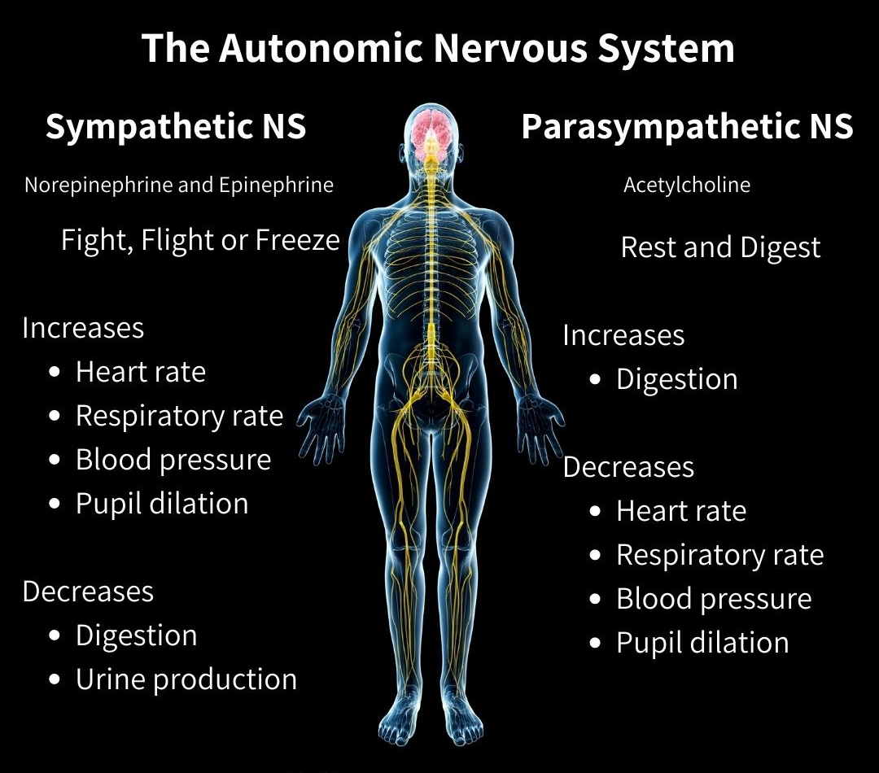
Benefits of Gratitude – The Science
https://www.standinguptopots.org/ANS101

Slide 11
Tips For Cultivating Gratitude!
Write a Thank You Card!
Do Something Kind For Your Neighbor!
Tell Someone How Much You Appreciate Them!
Acts of Kindness!
Write A List of Things That You’re Grateful For Today!
Appreciate What You’re Grateful For By Acting On It!
Write A List of Your Favorite Simple Pleasures
Show Appreciation To Someone Who Makes Your Day!
Focus on what went right each day!
Don’t save conversations of gratitude for Thanksgiving!
Promote sincere verbal or written expressions of thankfulness!
Find ways to help others in need!
It’s contagious – Be a role model!
Start your Morning With 3 Things You’re Grateful For!
Write A List Of Your Favorite Simple Pleasures!

Slide 12
How Do You Practice Gratitude?
Is it a “state” or a “trait” or BOTH For You!

Slide 13
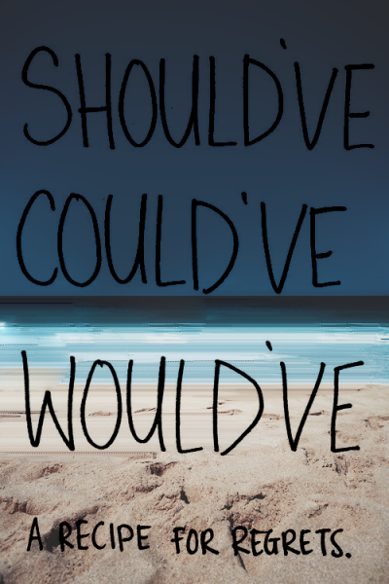
What Do You Need To Do Differently?

Slide 14
I’m grateful that you shared an hour of your day with me!
Questions or Comments!

